Slide 1
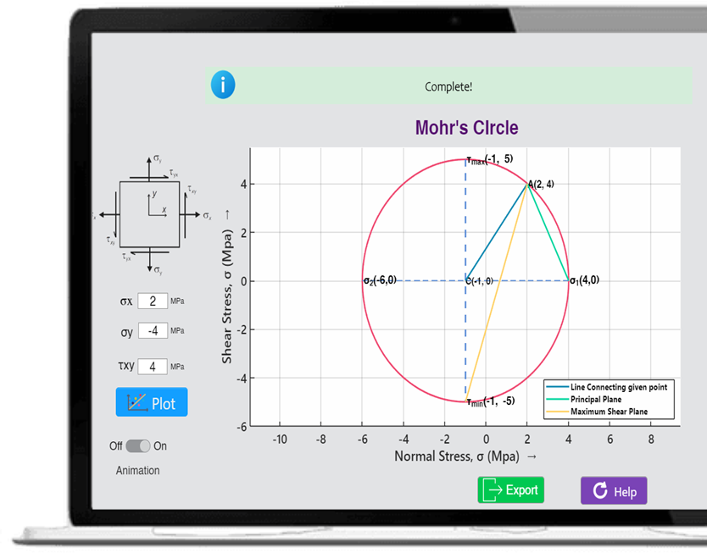
Mohr’s Circle and 2D Stress Calculator App
Presented By: Group 06
Md. Kawsar Ahmed (1904103) , Arif Ahmed Tusar (1904109)
Sultan Mahfuj (1904115), Abdullah Al Riyad (1904121), Tanvir Ahmed Sijan (1904127).

Slide 2

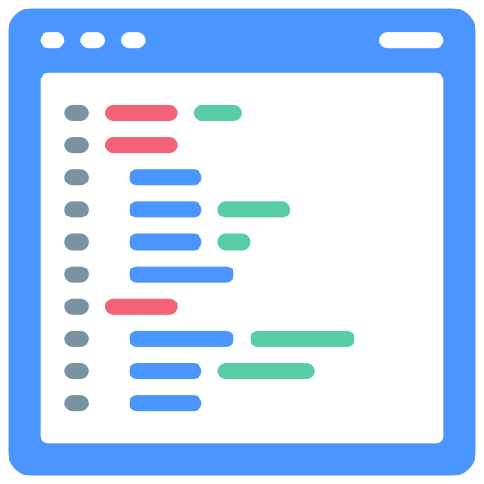




MATLAB
A programming language and numeric computing environment
Matrix manipulations, plotting of functions
Developed by MathWorks
Highly efficient for technical computing
More than 4.5 million users

Slide 3





Outline
Introduction
Objectives
Code Snippets
GUI
Application

Slide 4
Introduction
Introduction
Objectives
Code Snippets
GUI
Application

Slide 5

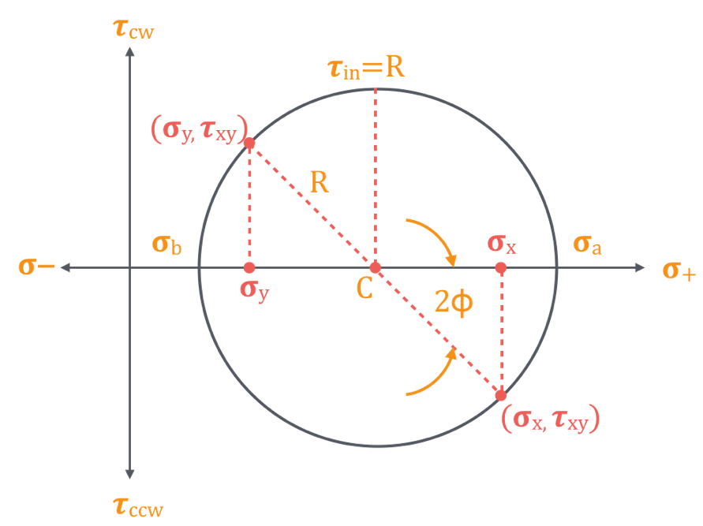


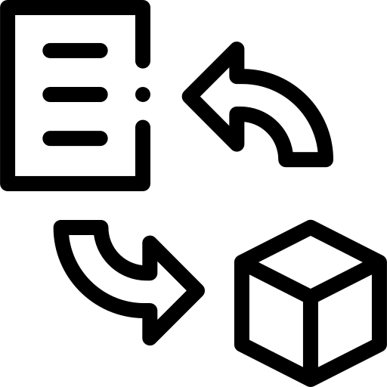
Mohr’s circle
Principal stress maximum shear stress
Relationships between normal and shear stress
Equations for plane stress

Slide 6
Objectives
Introduction
Objectives
Code Snippets
GUI
Application

Slide 7

Objectives
Construct Mohr's circle with different values of σ_{x}, σ_{y}, and τ_{xy}
Locate σ₁, σ₂, and τ_{max} on Mohr's circle.
Calculate principal stresses and maximum shear stress.
Find out the orientation of principal planes and maximum shear stress plane
Create a minimalistic, visually elegant app using MATLAB App Designer.

Slide 8
Code Snippets Review
Introduction
Objectives
Code Snippets Review
GUI
Application

Slide 9
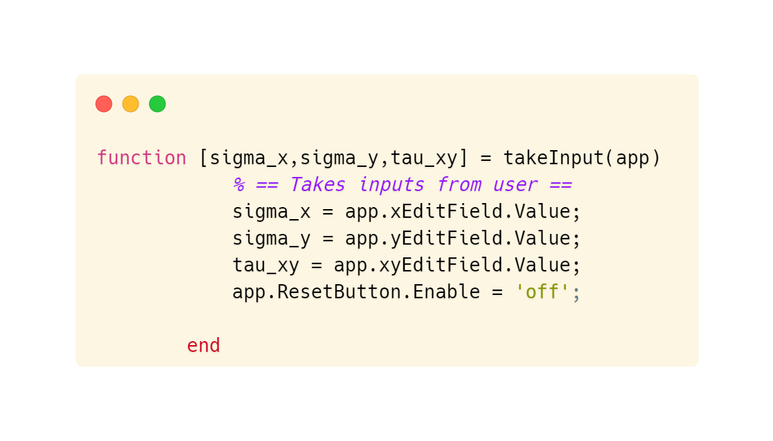

Taking Input From User

Slide 10
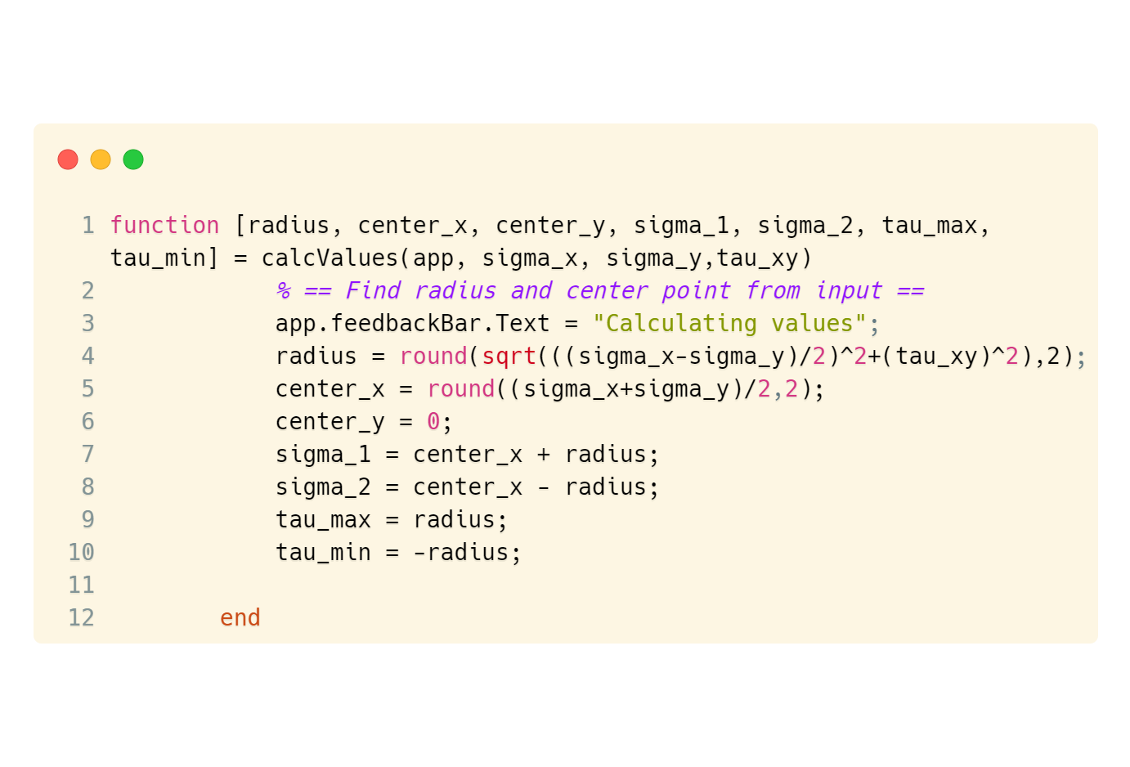
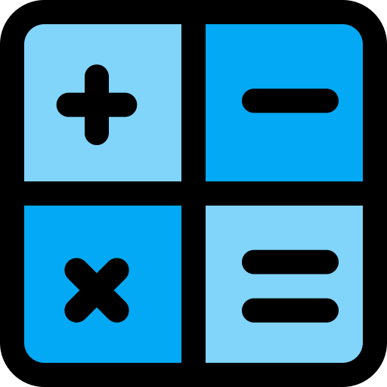
Radius & Center Calculation

Slide 11
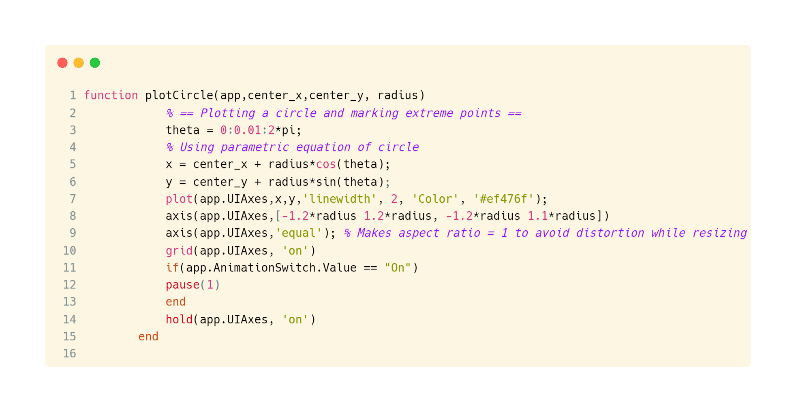

Plotting Mohr’s Circle

Slide 12
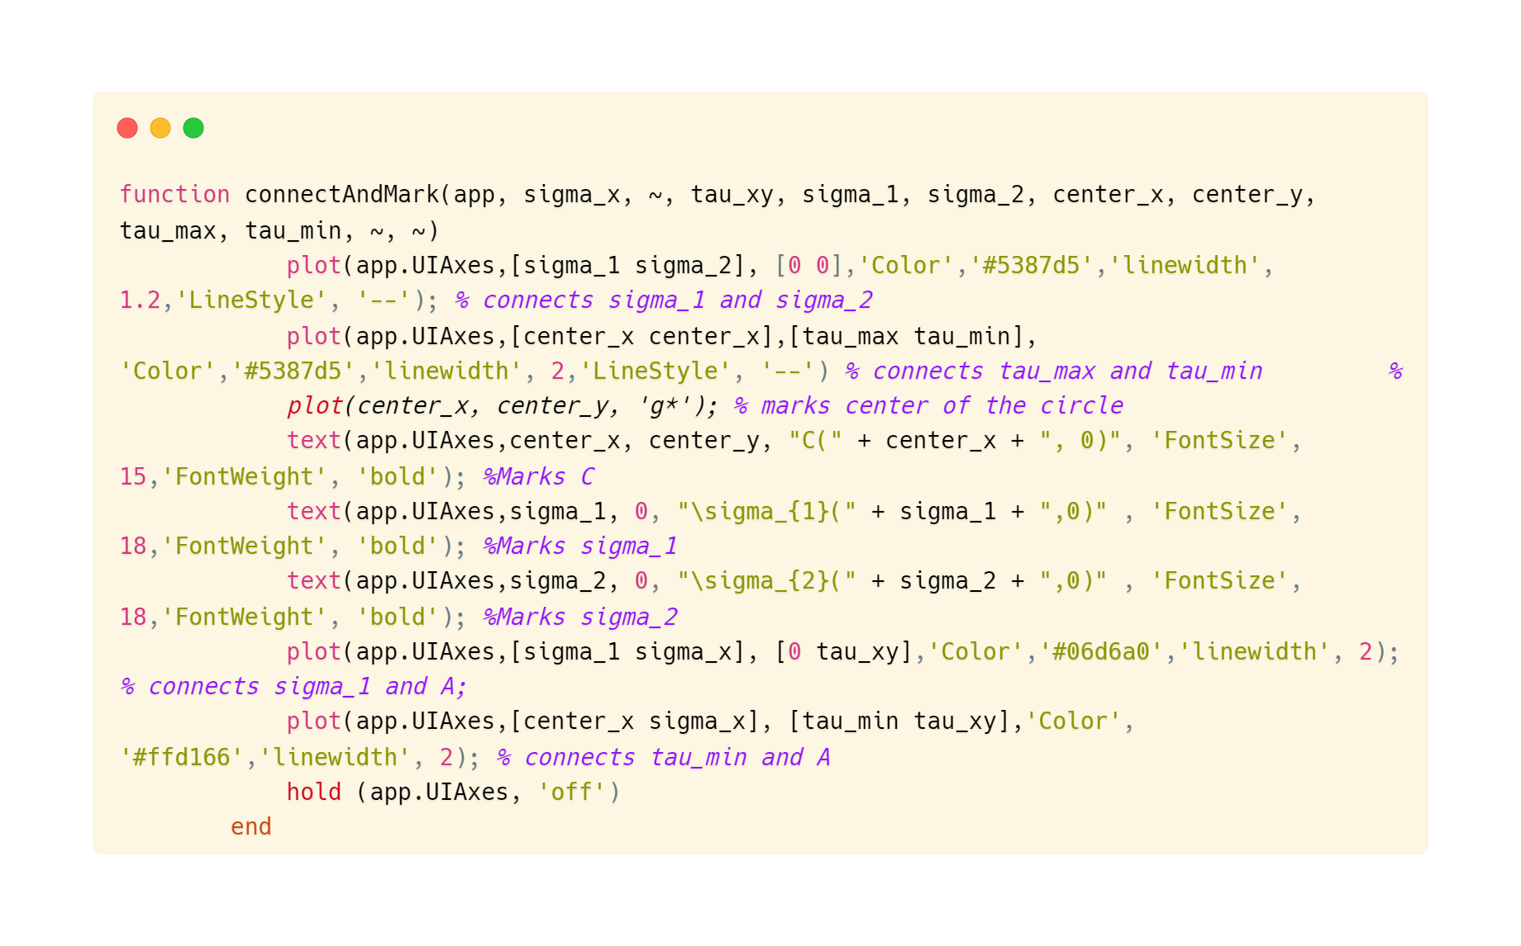

Connecting Points

Slide 13
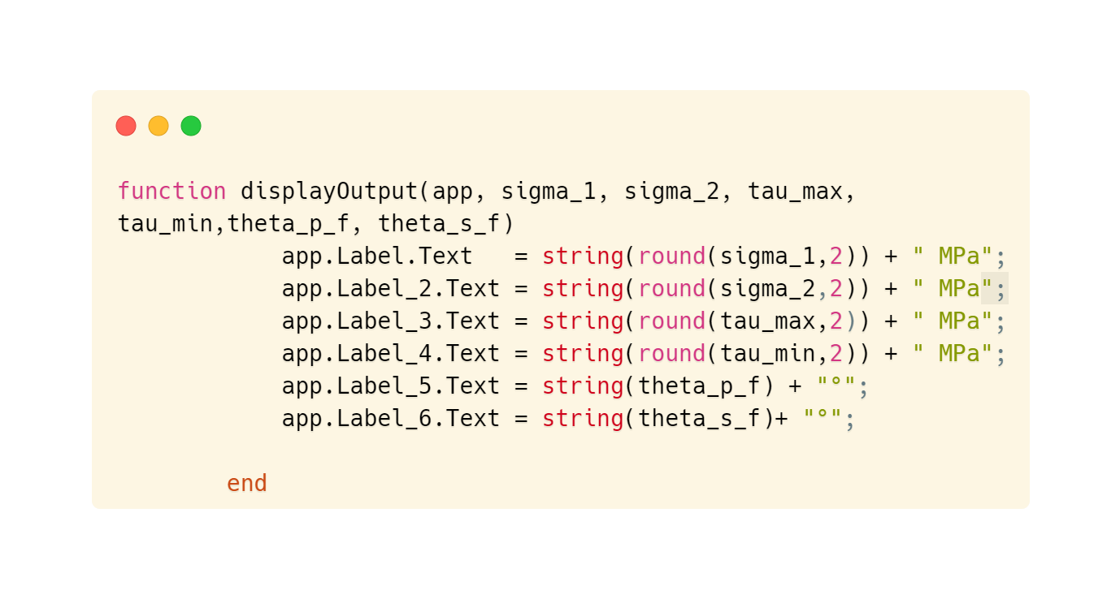

Display Results

Slide 14
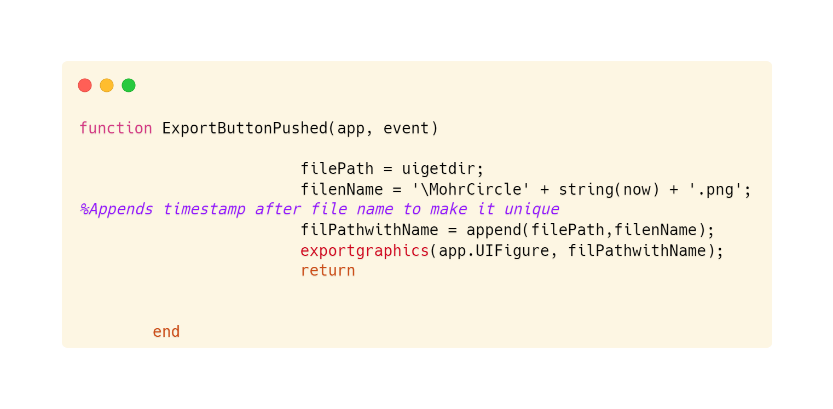

Plot Export

Slide 15
Graphical User Interface
Introduction
Objectives
Code Snippets
GUI
Application

Slide 16
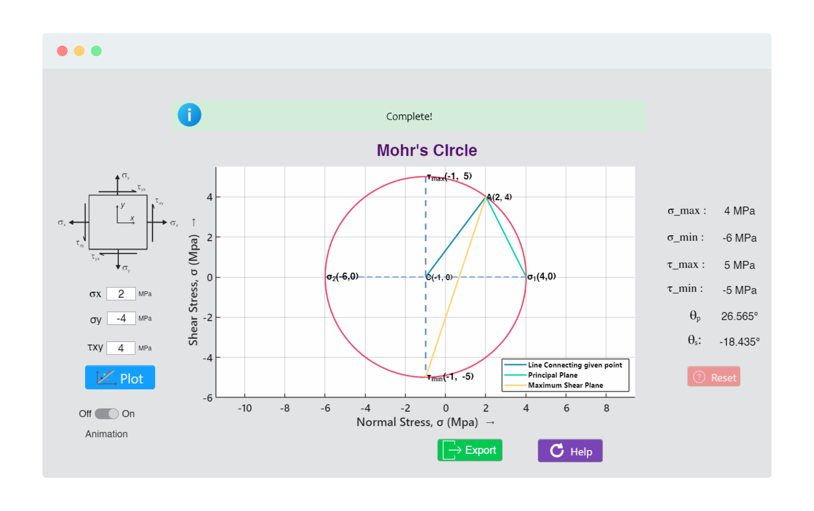
Animated Plot
Help file for ease of use
Visual Feedback

Slide 17

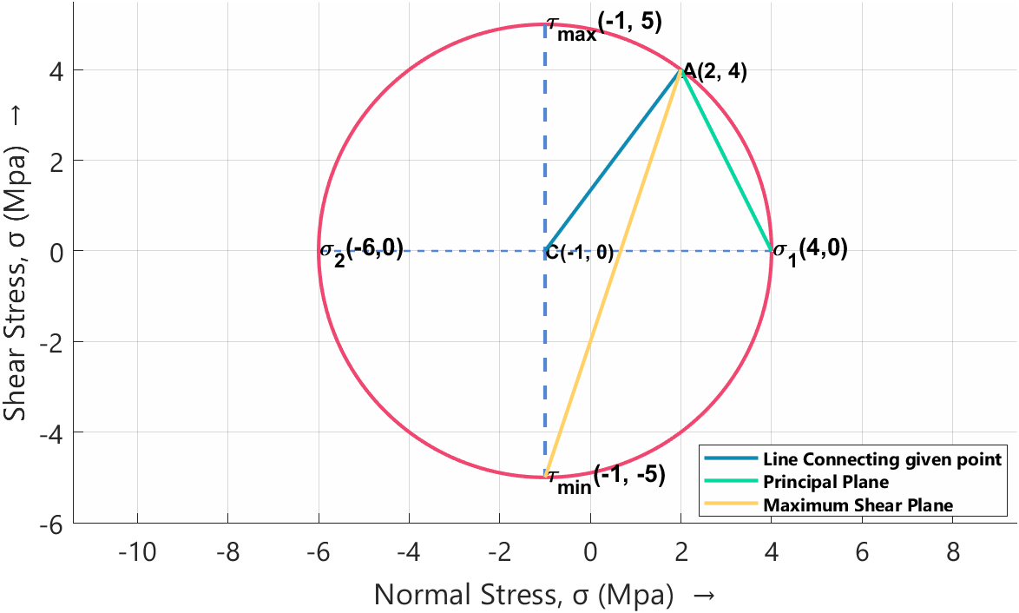
Export plot as a .png file
Exporting Data

Slide 18

Application
Introduction
Objectives
Code Snippets
GUI
Application

Slide 19


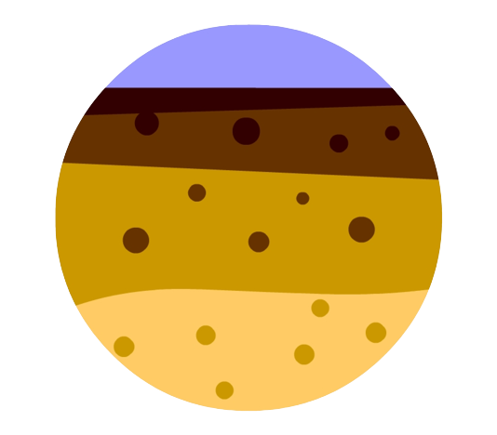

Engineering Applications
Evaluation of stress of any given point
Structural strength
Strength of soils
Automobile Industry
And many more……

Slide 20




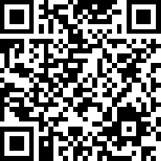
Conclusion
Evaluation and graphical presentations of the stresses by Mohr’s circle
Real life application
Minimalistic, visually elegant app is developed using MATLAB App Designer
Scan the QR code to access the source code on github

